Slide 1




Abundance and Biomass of the Sand Prawn Kraussillichirus kraussi in Richards Bay Harbour.
Zizipho Mamfengu¹
Lungelo Nsibande¹ , Ntuthuko Masikane^{1,2}
¹Department of Zoology, University of Zululand, KwaDlangezwa 3886, South Africa
²South African Institute for Aquatic Biodiversity, Makhanda, South Africa
A study on estuarine health indicators in a subtropical harbour.

Slide 2

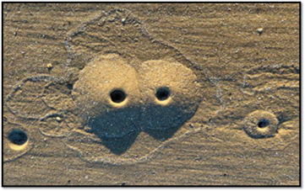
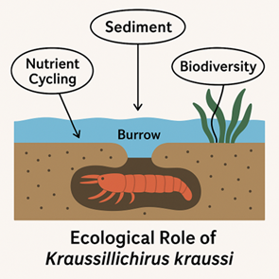
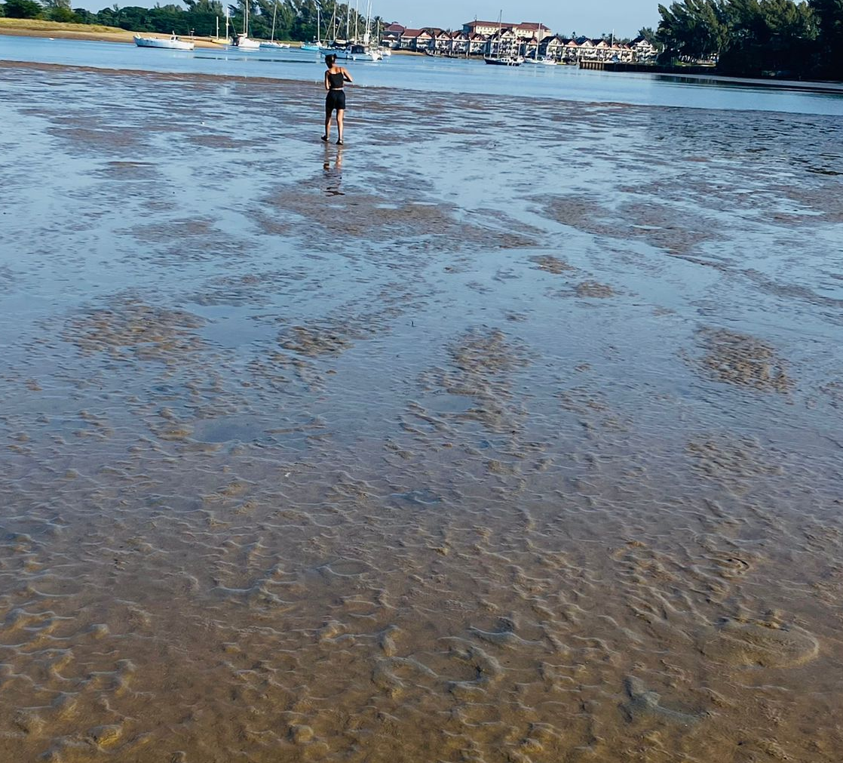
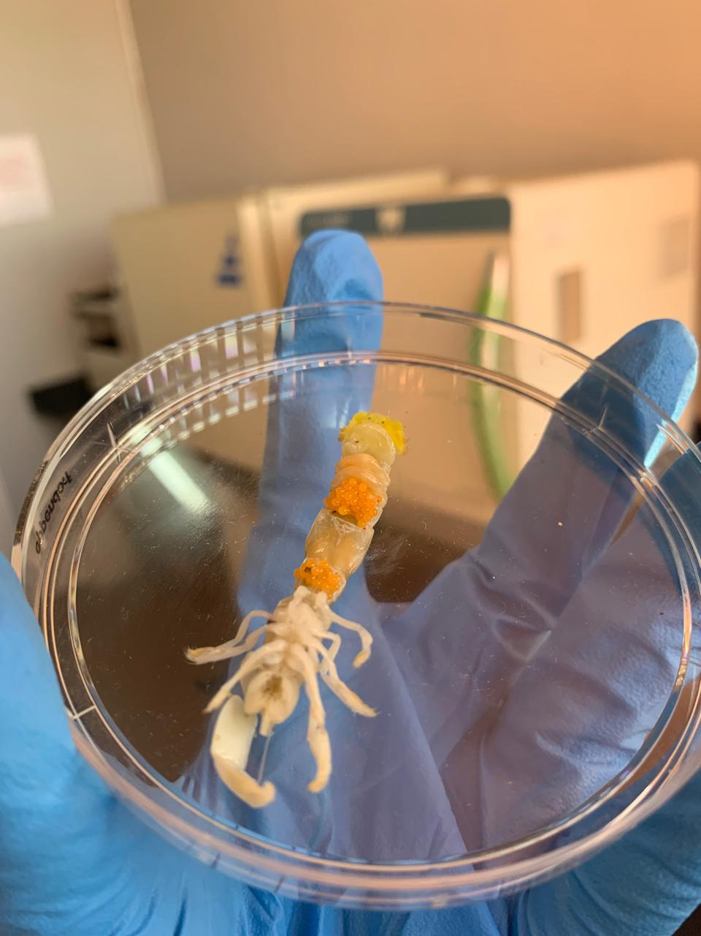
Introduction.
Kraussillichirus kraussi description.
Kraussillichirus kraussi is a small burrowing sand prawn which ranges from 10 to 60 mm in body length.
It is classified as an endobenthic organism that burrows in estuarine sediments.
It plays an important role in estuarine ecosystems (e.g., aerates sediments, enhances nutrient recycling and support structure of benthic food webs).

Slide 3
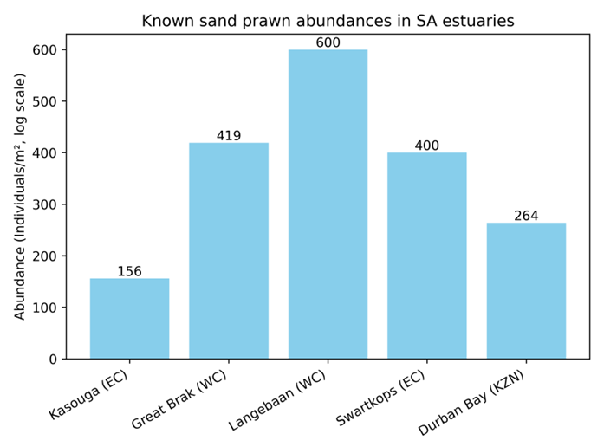
Introduction.
Previous Studies.
Temperature: High or low extremes reduce growth.
Salinity: Very high or low salinity decreases abundance.
Dissolved oxygen: Low oxygen limits survival, high oxygen allows active burrowing and promotes higher biomass.
Estuary type: Permanently open estuaries favor stable populations.

Slide 4
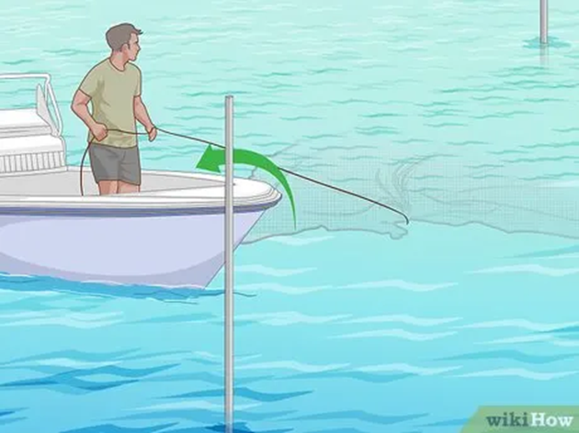
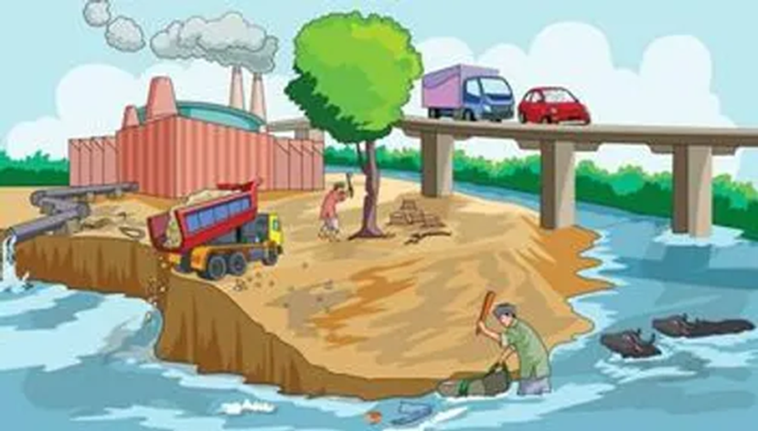
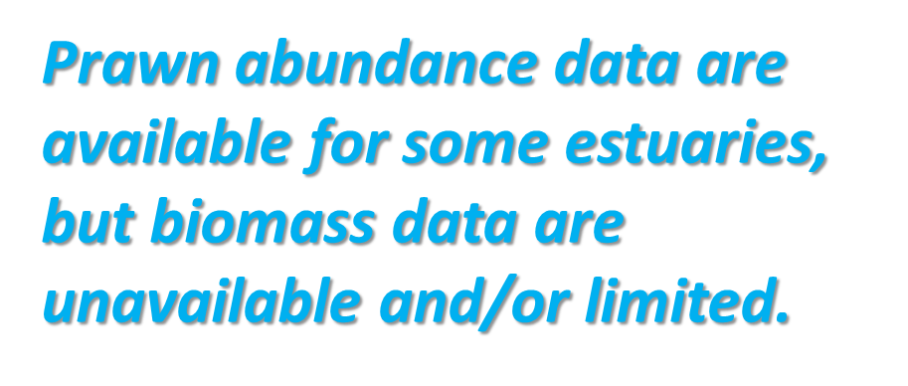
Problem statement.
Sand prawns as ecosystem engineers.
Sand prawns are ecologically and recreationally important.
Anthropogenic impacts on sand prawns.
Industrial pollution threatens their estuarine habitats.
Limited data on sand prawns.
Little is known about their abundance and biomass, yet these parameters can cost-effectively indicate habitat health.

Slide 5
Aim & Objectives.
Aim.
Assess the abundance and biomass relationship of Kraussillichirus kraussi in Richards Bay Harbour.
Objectives.
Quantify the abundance and biomass of Kraussillichirus kraussi at selected sites.
Define the abundance-biomass relationship over time (i.e., using regression).
Assess environmental stress using the abundance-biomass relationship (i.e., ABC curves).

Slide 6
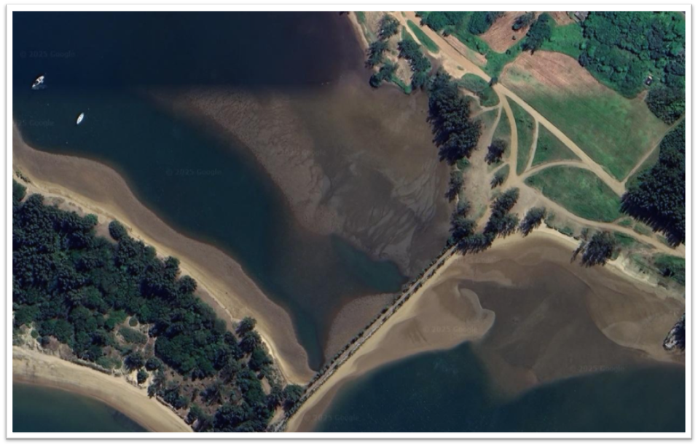
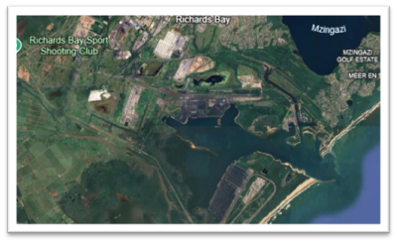



Materials & Methods.
Study Area.
Richards Bay Harbour (28°48′ S, 32.°04′ E) is a subtropical estuarine bay in KwaZulu-Natal.
It is one of South Africa’s largest and busiest deep-water ports, used for exporting coal and is popular for recreational fishing.
The harbour is earmarked for expansion.

Slide 7
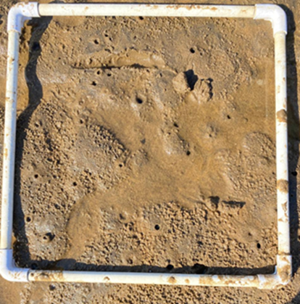
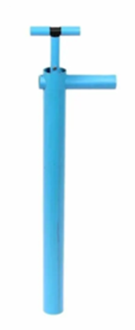
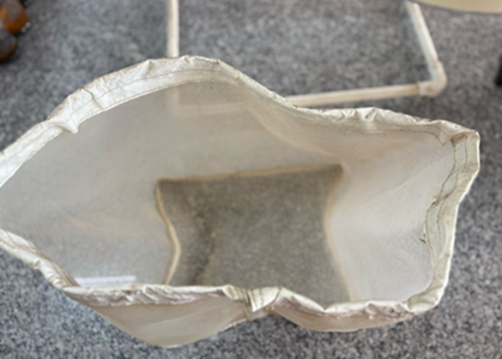
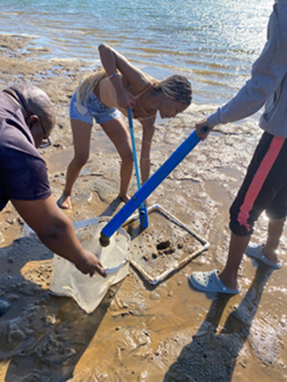
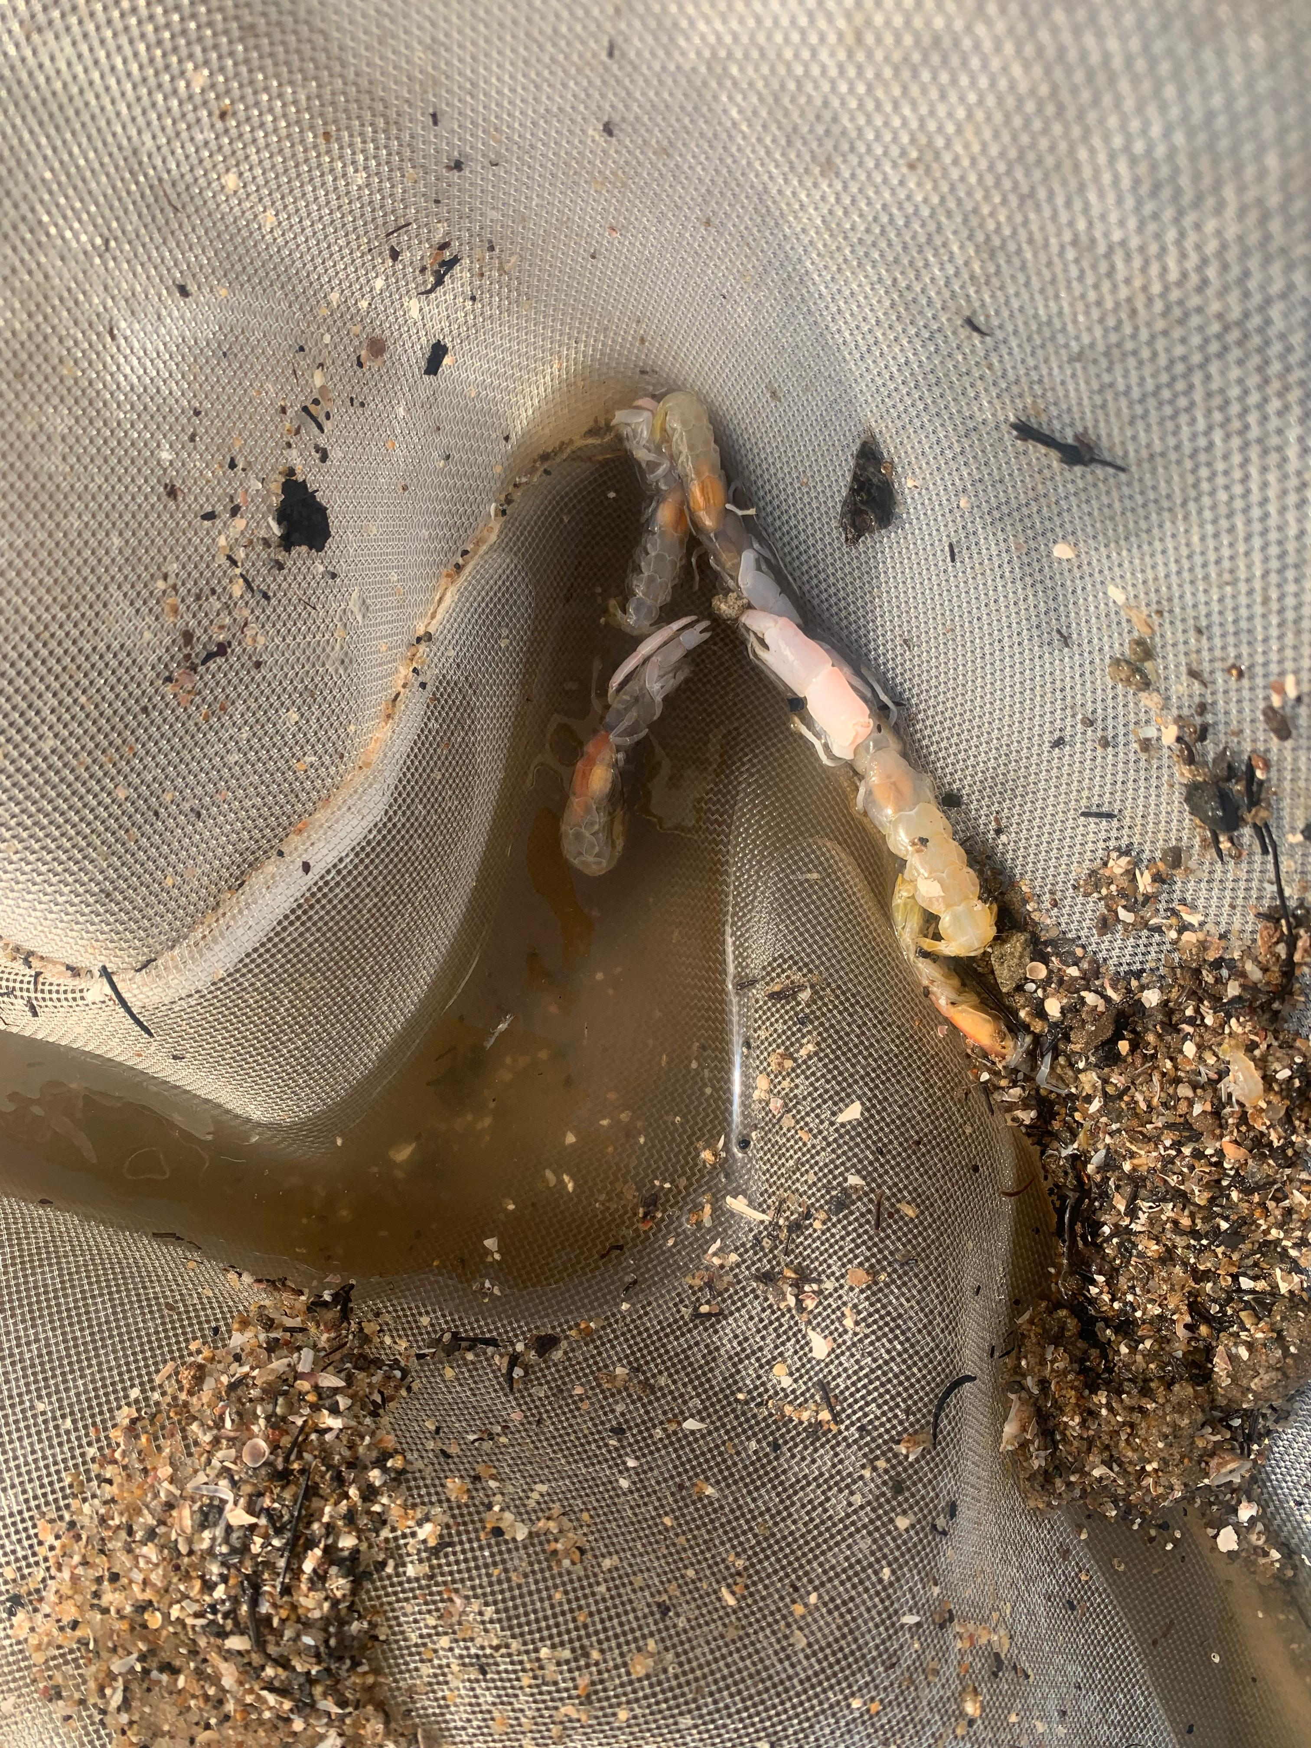
Materials & Methods.
Field trip.
Sand prawns were collected using a prawn pump from triplicate quadrats (area: 1 m²) at three sites over 4 months.
Prawn collection was standardised across quadrats (i.e., 10 random pumps per quadrat).

Slide 8
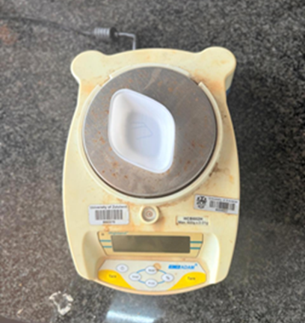
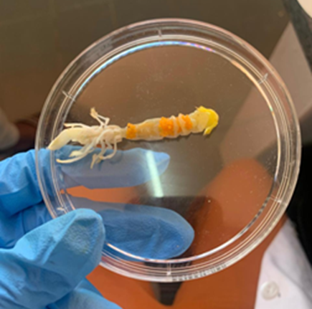
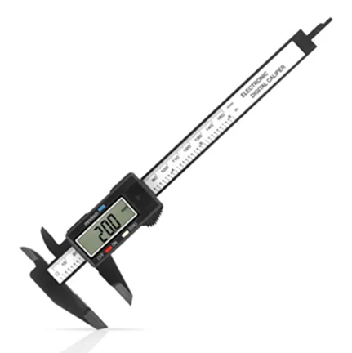
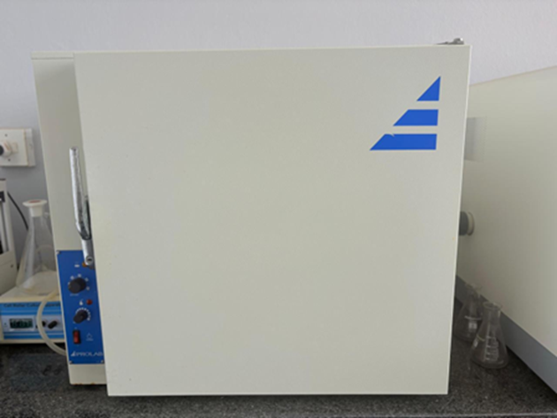
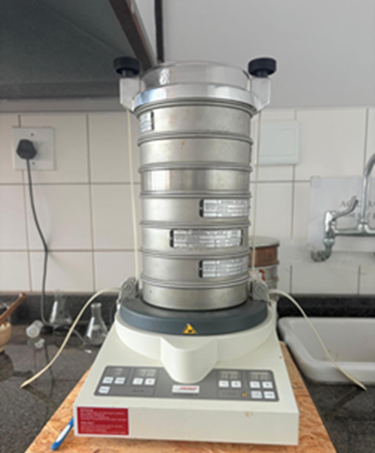
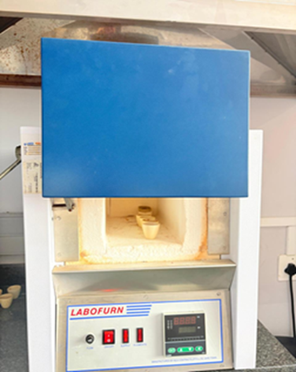
Materials & Methods.
Abundance and biomass estimation.
Abundance estimation: prawn counts (averaged over 3 quadrats per site, expressed as density).
Biomass estimated from dry weight.
Carapace and total length measured using a vernier calliper.
Grain size and Total Organic Content.
Triplicate sediment samples were also collected for the analyses of grain size (dry sieving method) and TOC (loss on ignition method).
Data analysis and visualization were performed using Programming Language (Python) and Gradistat v8.

Slide 9
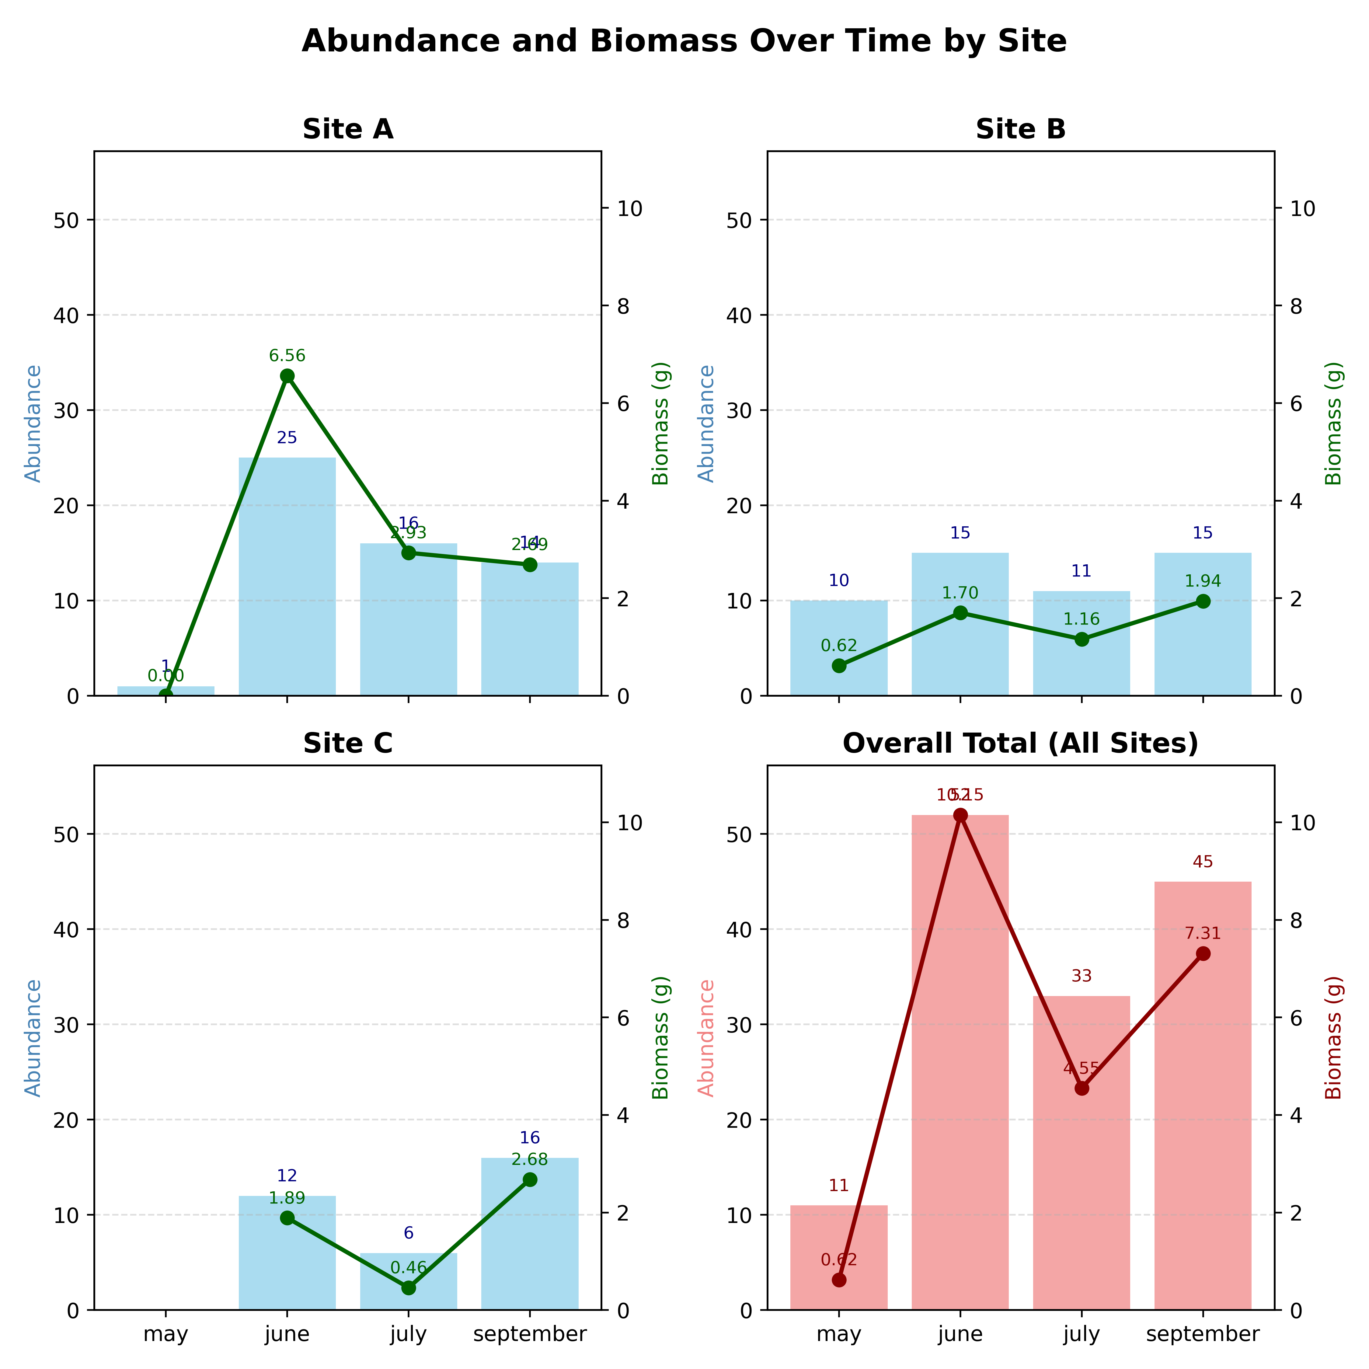
Results & Discussion.
Abundance and Biomass Analysis.
Kraussillichirus kraussi abundance and biomass peaked in June, indicating a possible recruitment period.
Site A abundance showed the highest variability, while Site B remained low but stable across months.
Biomass and abundance were positively correlated.
The July decline and September recovery suggest environmental influences and population resilience.

Slide 10
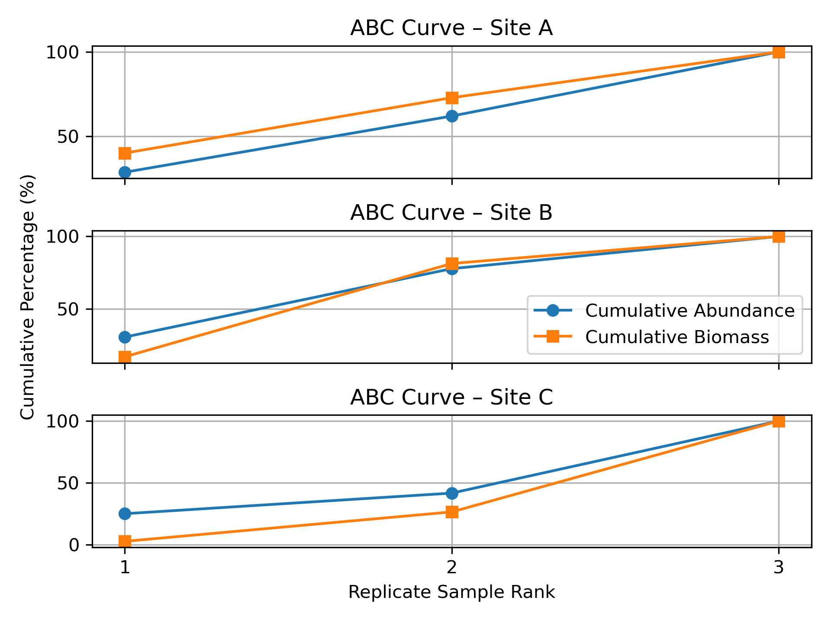
Results & Discussion.
Abundance-Biomass Comparison.
Abundance-Biomass Comparison curves showed that Sites A and B had higher biomass relative to abundance, indicating low disturbance.
Site C had higher abundance than biomass, suggesting severe disturbance.
This may be due to overharvesting of prawns for bait, potential sediment contamination or recreational activities. Site C is situated on Pelican Island, a popular recreational destination.

Slide 11
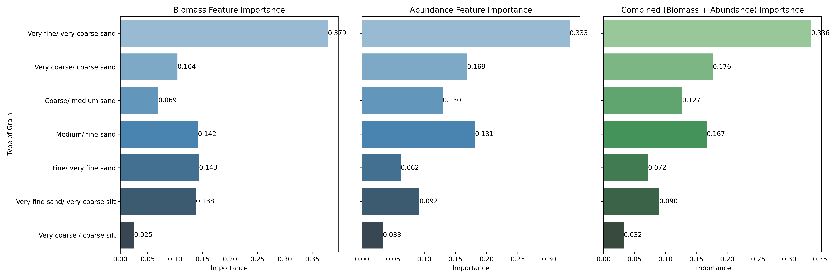
Results & Discussion.
Sediment Characteristics in relation to population patterns by medium and fine sand.
Sites with fine to medium sand (like Site B) better support biomass, while sites with coarse or mixed sediment (like Site A and C) show signs of stress or instability.

Slide 12
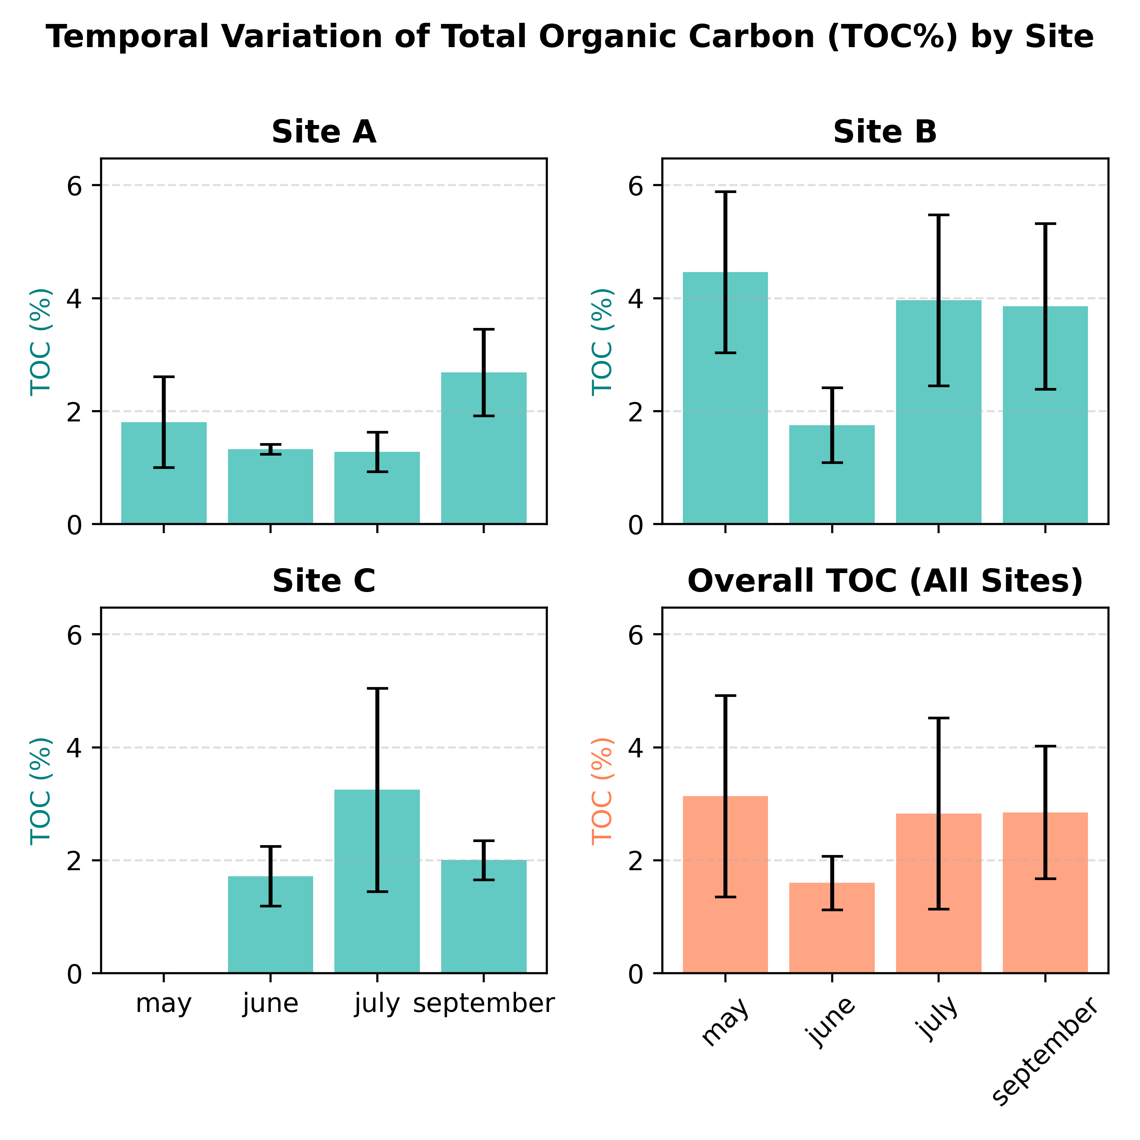
Results & Discussion.
Total Organic Content(%)
TOC varied both spatially and seasonally across sites.
Site B showed the highest TOC, suggesting greater organic accumulation in finer sediments.
Sites A and C had lower TOC, indicating better sediment oxygenation and coarser texture.
Overall TOC peaked in June–July and declined by September, reflecting seasonal organic input and decomposition patterns.

Slide 13
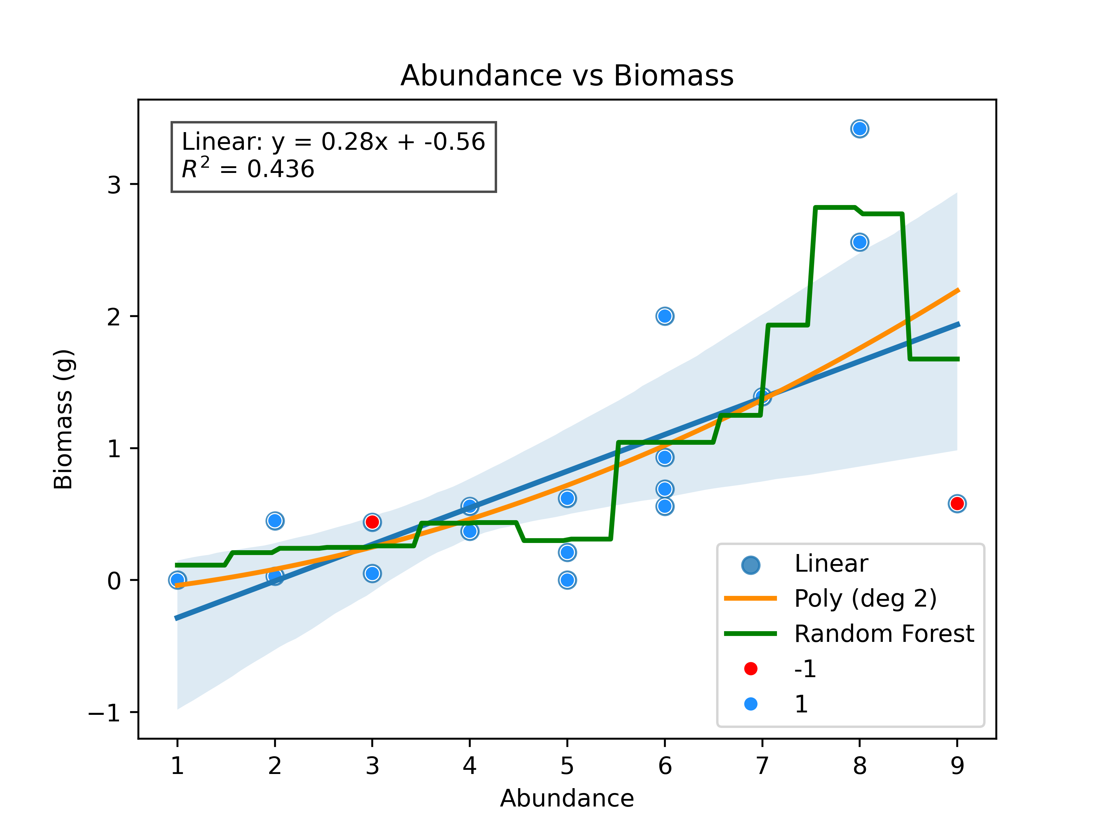
Results & Discussion.
Modeling Abundance- Biomass Patterns Using Regression Approaches.
The relationship between abundance and biomass was examined using linear, polynomial and Random Forest models.
There was a positive linear relationship between abundance and biomass.
The abundance and biomass relationship can be used as a quick and cost-effective tool for assessing ecosystem health in Richards Bay Harbour.

Slide 14
Conclusion.
Kraussillichirus kraussi abundance and biomass patterns reflect temporal and spatial variability in Richards Bay Harbour.
Peak values in June suggest a recruitment period, while the July dip and September recovery highlight environmental stress and resilience.
Site A showed high variability, Site B remained stable with high TOC% and Site C indicated disturbance likely due to recreational activity and sediment degradation.
ABC curves and regression models confirmed a positive correlation between abundance and biomass, validating their use as a cost-effective indicator of estuarine health.
Sediment texture and organic content are important drivers of prawn distribution, emphasising the need for sustainable habitat management amid industrial and recreational pressures.

Slide 15
Summary of Key Findings.
Population insights.
Peak abundance and biomass in June – likely recruitment period.
Site A: High variability, Site B: Stable, high TOC and Site C: Disturbed (recreational pressure).
Sediment & Organic Content.
Fine-medium sand supports biomass.
High TOC linked to stable populations.
Coarse/mixed sediment – signs of stress.
Population insights.
Positive correlation confirmed by regression models.
ABC curves:
Site A and B – Low disturbance.
Site C – High disturbance.
Sediment & Organic Content.
Sand prawns are ecosystem engineers and bioindicators.
Monitoring abundance and biomass is cost-effective.
Supports sustainable estuarine management.

Slide 16
References.
Yekani, C. and Froneman, W.P., 2025. Sand Prawns Mitigate the Impact of Prolonged Drought on the Biology of a Temporary Open/Closed Estuary. Diversity, 17:223.
Jerling HL. 2008. The zooplankton community of Richards Bay Harbour and adjacent Mhlathuze Estuary, South Africa. African Journal of Marine Science 30:55-62.
Mackey CF, Untiedt CB, Hein L. 2016. Local drivers of macrobenthos in the northern, central and southern KwaZulu-Natal Bight, South Africa. African Journal of Marine Sciences 38:105-121.
DWAF(Department of water affairs and forestry, South Africa). 2001. Benthic Macrofauna of the Great Brak Estuary, monitoring Results. Gibson RN, Atkinson RJA, Gordon JDM, Smith IP, Hughes DJ. 2011. Bioengineering effects of burrowing thalassinidean shrimps on marine soft-bottom ecosystems. Oceanography and marine biology: An annual review 49: 137-192.
Hanekom Nand Russel IA. 2015. Temporal changes in the macrobenthos of sand prawn (C.kraussi) beds in Swartvlei Estuary, South Africa. African Zoology, 50:41-51.
Pillay D, Branch GM, Forbes AT. 2007. The influence of bioturbation by the sand prawn callianassa kraussi on feeding and survival of the bivalve Eumarcia paupercula and the gastropod Nassarius kraussians. Journal of experimental marine biology and ecology 344:1-9.
Njozela C. 2012. The role of sand prawn, C.kraussi, as an ecosystem engineer in a temporarily open/closed Eastern Cape estuary, South Africa. Masters thesis, Rhodes University, South Africa.
Nel P. 2006a. Exploitation and biology of the bait organism Callianassa kraussi stebbing(crustacea; Decapoda - Thalassinidae) in Langebaan Lagoon. MSc thesis, University of Cape Town, South Africa.

Slide 17
Acknowledgements and Q&A.
University of Zululand, Department of Zoology – For academic support and resources.
Fieldwork team and lab assistants – for their dedication during sampling and data analysis.
Supervisors and mentors – for their guidance throughout the project.
Thank You!
ziziphomamfengu17@gmail.com

